Slide 1
Burden of Cardiovascular Disease
October 2022

Slide 2
Burden of Cardiovascular Disease
A record of the death and loss of health due to CV diseases
€
EPIDEMIOLOGICAL/PUBLIC HEALTH
ECONOMIC PERSPECTIVE
Morbidity
  It estimates the economic burden of a specific disease from the societal perspective.
The number of people in a population who are unwell or disabled, and the severity of their illness or disability
  Identifying the various cost components and who bears them
  Measuring the incidence of different cost components over the total burden (healthcare costs, non healthcare costs, productivity losses)
  Explaining the costs variability across patients
This measures for
Healthy Adjusted Life Years
DALYs – Disability Adjusted Life Years
QALYs – Quality Adjusted Life Years
The results can effectively help industry, policy-makers, healthcare managers, clinicians and patients to address:
Mortality
The number of people in a population who die as a result of a specific disease or disability
  Clinical management of the disease
  Cost containment measures
  Programming healthcare services across centres/regions
  Developing new interventions to reduce disease progression

Slide 3









Burden of Cardiovascular Disease
Cause of 50% of death across Europe
Systematic assessment of the CVD economic burden in ESC countries from economic and epidemiological perspectives.
Cost containment measures and inefficiencies
Programming healthcare services across centres/regions
Developing new interventions including economic models to reduce the burden of CVD
Essential scientific and economic evidence to support adapted policies to encourage healthcare practices and management aimed to reduce the burden of CVD
80% of premature and stroke is preventable
CVD can be prevented by addressing behavioral risk factors

Slide 4
Oxford-ESC Burden of cardiovascular disease
While recognizing that CVD is no longer just a health issue, but a significant financial and economic hardship for individuals, health systems and societies across the globe, the BoD project aims to estimate the economic burden of cardiovascular disease in the member countries of the ESC.
At present, there is a significant and undeniable lack of international, systematic and comparative evidence on the economic burden of CVD in ESC countries. The Oxford- ESC BoD project aims to fill this gap with new data, rigorously collected and validated according to highest academic standards and methodologies.

Slide 5
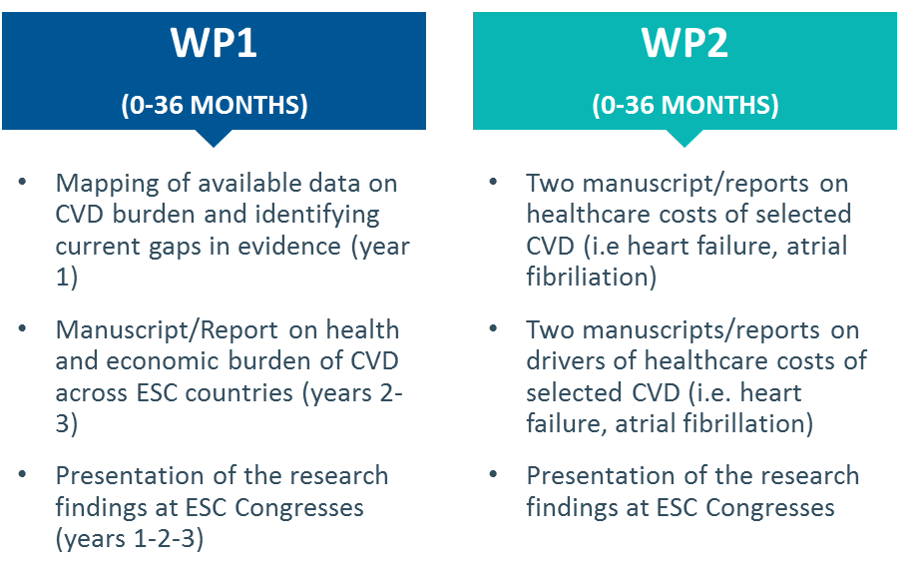
Oxford-ESC Burden of Disease project – WHAT?
Overview of the BoD deliverables per Work Package

Slide 6
Oxford-ESC BoD: HOW?
Methodology – WP1
WP1 will search for country-specific data on the different categories of burden of disease from international and national sources:
  ESC Atlas
  WHO
  Organisation for Economic Co-operation and Development (OECD),
  the Statistical Office of the European Communities (EUROSTAT)
  National Ministries of Health and statistical institutes.
When relevant data cannot be obtained from these sources, articles and reports will be consulted by performing targeted literature reviews.

Slide 7
Oxford-ESC BoD: HOW?
Methodology – WP2
WP2 will focus on estimating the healthcare costs associated with selected cardiovascular diseases in ESC countries at a patient level
Estimate the healthcare costs of:
  Heart Failure
  Atrial Fibrillation
  Valvular Heart Disease
  Cardiomyopathies in adults
  Chronic Ischaemic Cardiovascular Disease
  Acute Coronary Syndrome
Examine key determinants of variation in treatment pathways, resource utilization and costs within and between countries
WP2 will be initiated with the estimation of healthcare costs of Heart Failure and Atrial Fibrillation

